Slide 1
Chapter 07
Object Oriented Programming (SEng 2202)
Graphical User Interface
- Abstract Window Tool Kit

Slide 2
Objectives
After studying this chapter, students should be able to learn:
Abstract Window Tool Kit
Classes
Interfaces
Event Delegation Model
Displaying Text in frame
Drawing in Frame
Listeners
Various Components and their implementations
Handling mouse and key events

Slide 3
Introduction
User interaction with the program is of two types:
CUI (Character User Interface)
In CUI, user interacts with the application by typing characters or commands.
In CUI, user should remember the commands.
It is not user friendly.
GUI (Graphical User Interface)
In GUI, user interacts with the application through graphics.
GUI is user friendly.
GUI makes application attractive.
It is possible to simulate real object in GUI programs.
In Java to write GUI programs we can use AWT (Abstract Window Toolkit) package: java.awt, is a package that provides a set of classes and interfaces to create GUI programs.

Slide 4
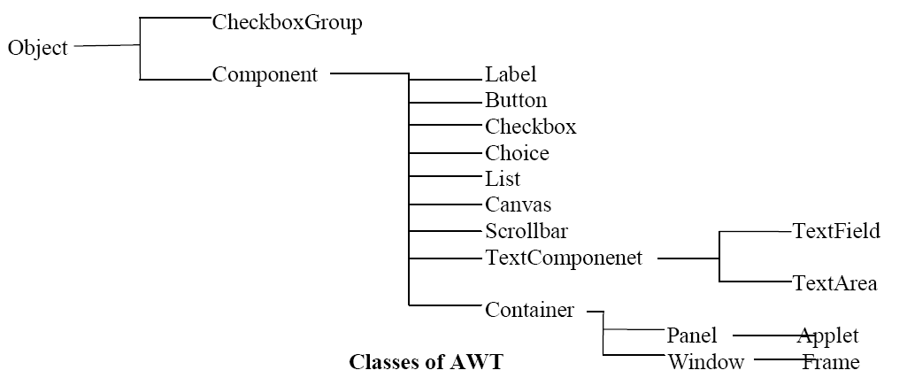
Abstract Window Tool Kit
A window represents a box shaped area on the screen.
Window does not have border and title.
A Frame is a top level window that is not contained in another window.
A Frame contains border and title.

Slide 5
Creating a Frame
We can create a Frame by creating Frame class object.
Frame obj = new Frame(); (or)
Create a class that extends Frame class then create an object to that class.
class MyClass extends Frame
MyClass obj = new MyClass();
After creating the Frame we need to set Frame width and height using setSize() method as:
f.setSize(400, 350);
We can display the frame using setVisible() method as:
f.setVisible(true);

Slide 6

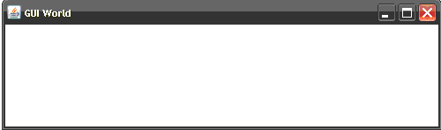
Frame – Example1
Program 1: Program to create a Frame without extending Frame class.
import java.awt.*;
class MyFrame
{
public static void main(String args[])
{ Frame f1 = new Frame ();
f1.setSize (500,150);
f1.setTitle ("GUI World");
f1.setVisible (true);
}
}
Output:

Slide 7

Frame – Example2
Program 2: Program to create a Frame by extending Frame class.
import java.awt.*;
class MyFrame extends Frame
{ public static void main(String args[])
{ MyFrame f1 = new MyFrame ();
f1.setSize (500,200);
f1.setTitle ("GUI World");
f1.setVisible (true);
}
}
Output:

Slide 8
Event-Delegation Model
Graphical representation of an object is called a component.
User interaction with the component is called event.
When an event is generated by the user on the component, component will delegate (hand over) the event to the listener.
The listener will delegate the event to one of its method.
The method is finally executed and the event is handled.
This is called Event-Delegation-Model.
Event-Delegation-Model is used in AWT to provide actions for components. In Event Delegation Model:
Attach the Listener to the component.
Implement all the methods of the Listener.
When an Event is generated one of these methods performs the required action.

Slide 9
Closing a Frame
We know Frame is also a component. We want to close the frame by clicking on its close button.
Follow these steps to see how to use event delegation model to do this:
Attach a listener to the frame component. Remember, all listeners are available in java.awt.event package.
The most suitable listener to the frame is ‘WindowListener’. It can be attached using addWindowListener () method as:
f.addWindowListener(WindowListener obj);
Note that the addWindowListener () method has a parameter that is expecting object of WindowListener interface. Since it is not possible to create an object to an interface, we should create an object to the implementation class of the interface and pass it to the method.

Slide 10
Contd.
Implement all the methods of the WindowListener interface.
The following methods are found in WindowListener interface:
public void windowActivated(WindowEvent e)
public void windowClosed(WindowEvent e)
public void windowClosing(WindowEvent e)
public void windowDeactivated(WindowEvent e)
public void windowDeiconified(WindowEvent e)
public void windowIconified(WindowEvent e)
public void windowOpened(WindowEvent e)
In all these methods, WindowListener interface calls windowClosing ( ) method when the frame is being closed. So, implementing this method alone is enough, as:
public void windowClosing (WindowEvent e)
{ //Close the application
System.exit (0);
}
For the remaining methods, we can provide empty body.

Slide 11
Contd.
So, when the frame is closed the body of this method is executed and the application gets closed.
In this way, we can handle the frame closing event.
An adapter class is an implementation class of a listener interface which contains all methods implemented with empty body.
For example, WindowAdapter is an adapter class of WindowListener interface. WindowAdapter in java.awt.event package contains all the methods of the WindowListener interface with an empty implementation (body).
If we can extend MyClass from this WindowAdapter class, then we need not write all the methods with empty implementation.
We can write only that method which we are in need.

Slide 12
Closing Frame - Example
Program 3: Program to close the frame using WindowAdapter class.
import java.awt.*;
class MyFrame extends Frame
{ public static void main(String args[])
{ MyFrame f1 = new MyFrame ();
f1.setSize (500,200);
f1.setTitle ("GUI World");
f1.setVisible (true);
f1.addWindowListener (new MyClass ());
}
}

Slide 13

Example – Contd.
class MyClass extends WindowAdapter
{ public void windowClosing (WindowEvent e)
{
System.exit (0);
}
}
Output:
Note: Click on close button, the Frame closes.

Slide 14
Contd.
The code of MyClass can be copied directly into addWindowListener () method, as:
f1.addWindowListener (new WindowAdapter ()
{
public void windowClosing(WindowEvent e)
{
System.exit (0);
}
});
We cannot find the name of MyClass anywhere in the code. It means the name of MyClass is hidden in MyFame class and hence MyClass is an inner class in MyFrame class whose name is not mentioned. Such an inner class is called ‘anonymous inner class’. An anonymous inner class is an inner class whose name is not written and for which only one object is created. A class for which only one object is created is called singleton class.

Slide 15
Displaying text in the Frame
We need paint() method whenever we want to display some new drawing or text or images in the Frame.
The paint () method is automatically called when a frame is created and displayed.
The paint () method refreshes the frame contents automatically when a drawing is displayed.
The paint () method takes Graphics Class object as parameter. Gaphics class is present in java.awt package.
To display some text or strings in the frame, we can take the help of drawstring () method of Graphics class as:
g.drawString (“Hai Readers”, x, y);
Here, the string “Hai Readers” will be displayed starting from the coordinates (x, y).
If we want to set some color for the text, we can use setColor () method of Graphics class as:
g.setColor (Color.red);

Slide 16
Contd.
There are two ways to set a color in awt.
The first way is by directly mentioning the needed standard color name from Color class as Color.black, Color.blue, Color.cyan, Color.pink, Color.red, Color.orange, Color.magenta, Color.darkGray, Color.gray, Color.lightGray, Color.green, Color.yellow and Color.white etc.
The second way to mention any color is by combining the three primary colors: red, green and blue while creating Color class object as:
Color c = new Color (r, g, b);
Here, r, g, b values can change from 0 to 255. 0 represents no color. 10 represent low intensity whereas 200 represent high intensity of color.
Ex: Color c = new Color (255, 0, 0); //red color
To set some font to the text, we can use setFont () method of Graphics class, as: g.setFont (Font object);
This method taked Font class object, which can be created as:
Font f = new Font (“SansSerif”, Font.BOLD, 30);
Here, “SansSerif” represents the font name; Font.BOLD represents the font style and 30 represents the font size in pixels.

Slide 17
Example - Displaying a message
Program 4: Program to display a message in the frame.
import java.awt.*;
import java.awt.event.*;
class Message extends Frame
{ Message ()
{ //code to close the Frame
this.addWindowListener (new WindowAdapter ()
{ public void windowClosing (WindowEvent we)
{
System.exit (0);
}
});
}
public static void main (String args[])
{ Message m = new Message ();
m.setTitle ("Simple Message");
m.setSize (650,150);
m.setVisible (true);
}

Slide 18

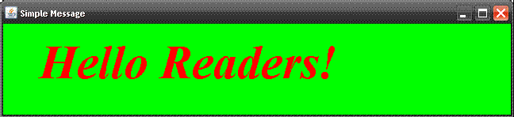
public void paint (Graphics g)
{ this.setBackground (Color.green);
g.setColor (Color.red);
Font f = new Font("Times New Roman",Font.BOLD+Font.ITALIC,60);
g.setFont (f);
g.drawString ("Hello Readers!”, 50, 100);
}
}
Output:

Slide 19
Drawing in the Frame
Graphics class of java.awt package has the following methods which help to draw various shapes.
drawLine (int x1, int y1,int x2, int y2): to draw a line connecting (x1, y1) and (x2, y2).
drawRect (int x, int y, int w, int h): draws outline of the rectangle, rectangles top left corner starts at (x, y) the width is w and height is h.
drawRoundRect (int x, int y, int w, int h, int arcw, int arch): draws the outline of the rectangle with rounded corners. Rectangles top left corner starts at (x, y) the width is w and height is h. The rounding is specified by arcw and arch.
drawOval (int x, int y, int w, int h): This method draws a circle or ellipse.
drawArc(int x, int y, int w, int h, int sangle, int aangle): draws an arc where sangle stands for starting angle and aangle stands for ending angle.

Slide 20
Contd.
drawPolygon (int x[], int y[], int n): This method draws a polygon that connects pairs of coordinates . Here, x[] is an array which holds x coordinates of points and y[] is an array which holds y coordinates, n represents the number of pairs of coordinates.
To fill any shape with a desired color, first of all we should set a color using setColor () method. Then any of the following methods will draw those respective shapes by filling with the color.
fillRect (int x, int y, int w, int h): Draws a rectangle and fills it with the specified color.
drawRoundRect (int x, int y, int w, int h, int arcw, int arch): Draws filled rectangle with rounded corners.
drawOval (int x, int y, int w, int h): Draws filled oval with a specified color.
drawArc(int x, int y, int w, int h, int sangle, int aangle): Draws an arc and fills it with a specified color.
drawPolygon (int x[], int y[], int n): Draws and fills a polygon with a specified color.

Slide 21
Example – Drawing shapes
Program 5: Program to draw different shapes in the frame.
import java.awt.*;
import java.awt.event.*;
class Draw1 extends Frame
{ Draw1 ()
{ this.addWindowListener (new WindowAdapter ()
{ public void windowClosing(WindowEvent we)
{
System.exit (0);
}
});
}
public static void main (String args[])
{ Draw1 d = new Draw1 ();
d.setTitle ("Simple Message");
d.setSize (650,350);
d.setVisible (true);
}

Slide 22

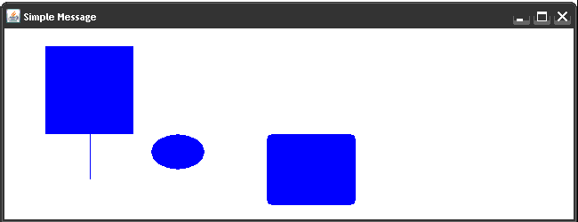
public void paint (Graphics g)
{ g.setColor (Color.blue);
g.drawLine (100, 100, 100, 200);
g.fillRect (50, 50, 100, 100);
g.fillRoundRect (300, 200, 100, 80, 10, 10);
g.fillOval (170, 150, 60, 40);
}
}
Output:

Slide 23
Displaying images in the frame
Load the image into Image class object using getImage () method of Toolkit class.
Image img = Toolkit.getDefaultToolkit ().getImage ("diamonds.gif");
But, loading the image into img will take some time, for this purpose we need MediaTracker class. Add image to MediaTracker class and allot an identification number to it starting from 0, 1...
MediaTracker track = new MediaTracker (this);
track.addImage (img, 0);
Now, MediaTracker keeps JVM waiting till the image is loaded completely. This is done by waitForId () method.
track.waitForId (0);
Once the image is loaded and available in img, then we can display the image using drawImage () method of Graphics class as: g.drawImage (img, 50, 50, null);
Here null represents ImageObserver class object which is not required. ImageObserver is useful to store history of how the image is loaded into the Object.

Slide 24
Example – Drawing image
Program 6: Program to display image on the frame using awt.
import java.awt.*;
import java.awt.event.*;
class Images extends Frame
{ Image img;
Images ()
{ img = Toolkit.getDefaultToolkit().getImage ("Fruit.jpg");
MediaTracker track = new MediaTracker (this);
track.addImage (img,0);
try
{
track.waitForID (0);
}
catch (InterruptedException ie){}
addWindowListener (new WindowAdapter ()
{ public void windowClosing (WindowEvent we)
{
System.exit (0);
}
});
}

Slide 25

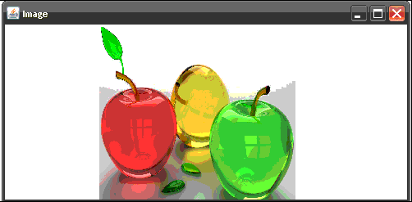
public void paint(Graphics g)
{
g.drawImage (img, 120, 20, 240, 240, null);
}
public static void main(String args[])
{ Images ob = new Images();
ob.setTitle("Image");
ob.setSize(500,250);
ob.setVisible(true);
}
}
Output:

Slide 26
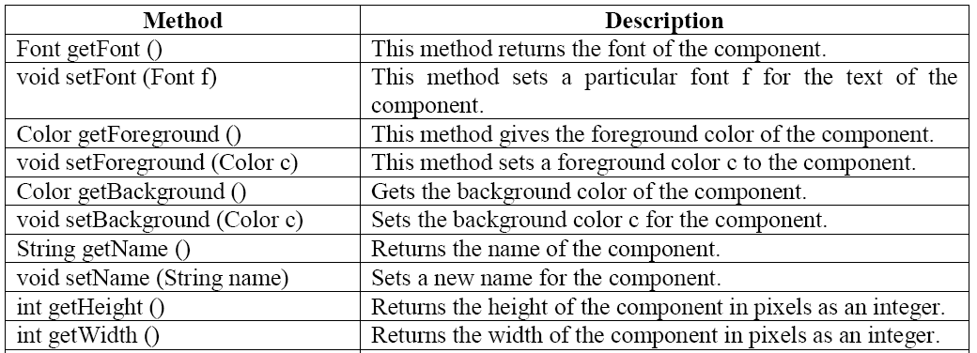
Component Class
A component is a graphical representation of an object on the screen.
For example, push buttons, radio buttons, menus etc are components. Even frame is also a component.
The Component class available in java.awt package contains the following methods which are applicable to any component.

Slide 27
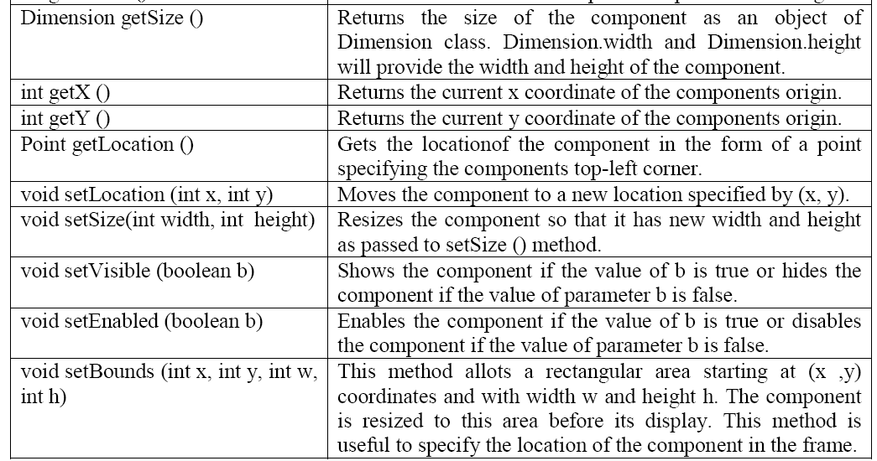
After creating a component, we should add the component to the frame. For this purpose, add () method is used.
f.add (component); where f is frame class object.
Similarly, to remove a component from the frame, we can use remove () method as:
f.remove (component); where f is frame class object.

Slide 28
Contd.
Frame class contains a method called setLayout (). setLayout () is useful to set a layout for the frame.
A layout represents a manner of arranging components in the frame. All layouts are represented as implementation classes of LayoutManager interface.
The following layouts are available in AWT:
FlowLayout: FlowLayout is useful to arrange the components in a line after the other. When a line is filled with components, they are automatically placed in the next line.
BorderLayout: BorderLayout is useful to arrange the components in the 4 borders of the frame as well as in the center. The borders are specified as South, North, East, West and Center.
CardLayout: A cardLayout treats each component as a card. Only one card is visible at a time and it arranges the components as a stack of cards.

Slide 29
Contd.
GridLayout: It is useful to divide the display area into a two dimensional grid form that contains several rows and columns. The display area is divided into equal sized rectangles and one component is placed in each rectangle.
GridBagLayout: This layout is more flexible as compared to other layouts since in this layout the components can span more than one row or column and the size of the components can be adjusted to fit the display area.
The following points are helpful to understand how to work with a layout manager:
To set a layout for out components, we can pass the layout class object to the setLayout () method as: setLayout (new FlowLayout ());
Suppose, we do not want to set any layout, then we should pass null to the setLayout () method as: setLayout (null);
Suppose, we do not use setLayout () method at all, then the Java compiler assumes a default layout manager. The default layout in case of a frame is BorderLayout.

Slide 30
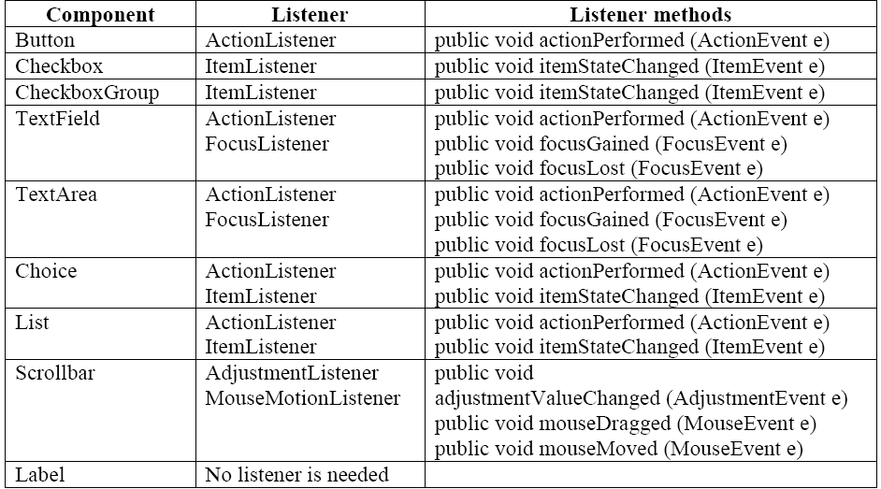
Listeners and Listener Methods
Listeners are available for components.
A Listener is an interface that listens to an event from a component. Listeners are available in java.awt.event package.
The methods in the listener interface are to be implemented, when using that listener.

Slide 31
Creating Push Buttons
Button class is useful to create push buttons.
A push button triggers a series of events.
To create push button:
Button b1 =new Button("label");
To get the label of the button:
String l = b1.getLabel();
To set the label of the button:
b1.setLabel("label");
To get the label of the button clicked:
String str = ae.getActionCommand(); where ae is object of ActionEvent

Slide 32
Example – Creating buttons
Program 7: Program to create push buttons.
import java.awt.*;
import java.awt.event.*;
class MyButton extends Frame implements ActionListener
{ Button b1, b2;
MyButton ()
{ setLayout (null);
b1 = new Button ("Red");
b2 = new Button ("Yellow");
b1.setBounds (100, 50, 75, 40);
b2.setBounds (100, 120, 75, 40);
b1.addActionListener (this);
b2.addActionListener (this);
add (b1);
add (b2);
addWindowListener (new WindowAdapter ()
{ public void windowClosing (WindowEvent we)
{ System.exit (0);
}
});
}

Slide 33

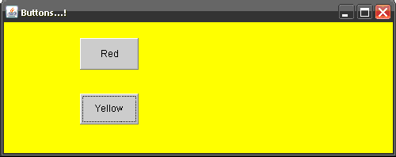
public void actionPerformed (ActionEvent ae)
{ String str = ae.getActionCommand ();
if (str.equals ("Red") )
setBackground (Color.red);
if (str.equals ("Yellow"))
setBackground (Color.yellow);
}
public static void main(String args[])
{ MyButton ob = new MyButton ();
ob.setSize (500,200);
ob.setTitle ("Buttons...!");
ob.setVisible (true);
}
}
Output:

Slide 34
Checkbox
A Checkbox is a square shapped box which provides a set of options to the user.
To create a Checkbox: Checkbox cb = new Checkbox ("label");
To create a checked Checkbox: Checkbox cb = new Checkbox ("label", null, true);
To get the state of a Checkbox: boolean b = cb.getState ();
To set the state of a Checkbox: cb.setState (true);
To get the label of a Checkbox: String s = cb.getLabel ();

Slide 35
Example – Creating Checkbox
Program 8: Program to create checkboxes.
import java.awt.*;
import java.awt.event.*;
class MyCheckbox extends Frame implements ItemListener
{ Checkbox cb1, cb2;
String msg;
MyCheckbox ()
{ setLayout (new FlowLayout ());
cb1 = new Checkbox ("Bold", null, true);
cb2 = new Checkbox ("Italic");
add (cb1);
add (cb2);
cb1.addItemListener (this);
cb2.addItemListener (this);
addWindowListener (new WindowAdapter ( )
{ public void windowClosing (WindowEvent we)
{ System.exit (0);
}
});
}

Slide 36
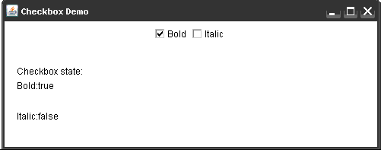
public void itemStateChanged (ItemEvent ie)
{
repaint ();
}
public static void main (String args[])
{ MyCheckbox ob = new MyCheckbox ();
ob.setTitle ("Checkbox Demo");
ob.setSize (500,200);
ob.setVisible (true);
}
public void paint (Graphics g)
{ g.drawString ("Checkbox state:", 20, 100);
msg = "Bold:" + cb1.getState() ;
g.drawString (msg, 20, 120);
msg = "Italic:" + cb2.getState();
g.drawString (msg, 20, 160);
}
}
Output:

Slide 37
Radio Button
A Radio button represents a round shaped button such that only one can be selected from a panel.
Radio button can be created using CheckboxGroup class and Checkbox classes.
To create a radio button: CheckboxGroup cbg = new CheckboxGroup ();
Checkbox cb = new Checkbox ("label", cbg, true);
To know the selected checkbox:
Checkbox cb = cbg.getSelectedCheckbox ();
To know the selected checkbox label:
String label = cbg.getSelectedCheckbox ().getLabel ();

Slide 38
Example – Creating Radio button
Program 9: Program to create Radio Button.
import java.awt.*;
import java.awt.event.*;
class MyRadio extends Frame implements ItemListener
{ String msg = "";
CheckboxGroup cbg;
Checkbox y, n;
MyRadio ()
{ setLayout (new FlowLayout());
cbg = new CheckboxGroup ();
y = new Checkbox ("YES", cbg, true);
n = new Checkbox ("NO", cbg, false);
add (y); add (n);
y.addItemListener (this);
n.addItemListener (this);
addWindowListener (new WindowAdapter()
{ public void windowClosing (WindowEvent we)
{ System.exit (0);
}
});
}

Slide 39

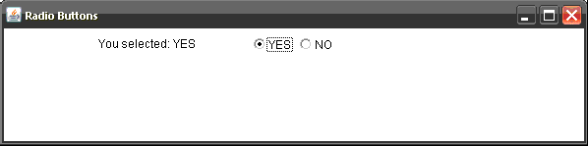
public void itemStateChanged (ItemEvent ie)
{
repaint ();
}
public void paint(Graphics g)
{ g.drawString("You selected:"+cbg.getSelectedCheckbox ().getLabel(),100,50);
}
public static void main(String args[])
{ MyRadio ob = new MyRadio ();
ob.setTitle ("Radio Buttons");
ob.setSize (600,200);
ob.setVisible (true);
}
}
Output:

Slide 40
Choice Menu
Choice menu is a popdown list of items. Only one item can be selected.
To create a choice menu: Choice ch = new Choice();
To add items to the choice menu: ch.add ("text");
To know the name of the item selected from the choice menu:
String s = ch.getSelectedItem ();
To know the index of the currently selected item:
int i = ch.getSelectedIndex(); returns -1, if nothing is selected.

Slide 41
Example – Creating a Choice box
Program 10: Program to create a choice box.
import java.awt.*;
import java.awt.event.*;
class MyChoice extends Frame implements ItemListener
{ Choice ch;
MyChoice ()
{ setLayout (new FlowLayout ());
ch = new Choice();
ch.add ("India"); ch.add ("Pakistan");
ch.add ("Afghanistan"); ch.add ("China");
ch.add ("Sri Lanka"); ch.add ("Bangladesh");
add (ch);
ch.addItemListener (this);
addWindowListener (new WindowAdapter()
{
public void windowClosing (WindowEvent we)
{ System.exit (0);
}
});
}

Slide 42

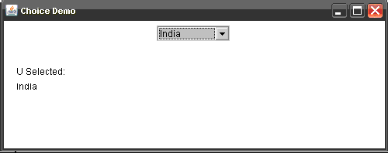
public void itemStateChanged (ItemEvent ie)
{ repaint ();
}
public void paint (Graphics g)
{ g.drawString ("U Selected: ", 20, 100);
g.drawString (ch.getSelectedItem (), 20, 120);
}
public static void main(String args[])
{ MyChoice ob = new MyChoice ();
ob.setSize (500,200);
ob.setTitle ("Choice Demo");
ob.setVisible (true);
}
}
Output:

Slide 43
List Box
A List box is similar to a choice box, it allows the user to select multiple items.
To create a list box:
List lst = new List(); (or)
List lst = new List (3, true); initially displays 3 items. The next parameter true represents that the user can select more than one item from the available items. If it is false, then the user can select only one item.
To add items to the list box: lst.add("text");
To get the selected items: String x[] = lst.getSelectedItems();
To get the selected indexes: int x[] = lst.getSelectedIndexes ();

Slide 44
Example – List box
Program 11: Program to create a list box.
import java.awt.*;
import java.awt.event.*;
class MyList extends Frame implements ItemListener
{ List ch;
int[] msg;
MyList ()
{ setLayout (new FlowLayout());
ch = new List(3,true); ch.add ("India");
ch.add ("Pakistan"); ch.add ("Afghanistan");
ch.add ("China"); ch.add ("Sri Lanka");
ch.add ("Bangladesh");
add (ch);
ch.addItemListener (this);
addWindowListener (new WindowAdapter ()
{ public void windowClosing (WindowEvent we)
{ System.exit (0);
}
});
}

Slide 45
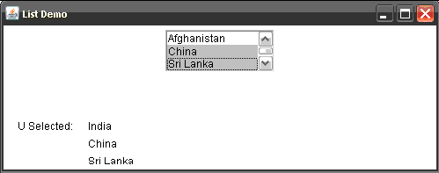
public void itemStateChanged (ItemEvent ie)
{ repaint ();
}
public void paint (Graphics g)
{ try
{ g.drawString ("U Selected:", 20, 150);
msg = ch.getSelectedIndexes ();
for (int i =0;i<msg.length; i++)
{ String item = ch.getItem (msg[i]);
g.drawString (item, 100, 150+i*20);
}
}catch (NullPointerException ie){}
}
public static void main (String args[])
{ MyList ob = new MyList ();
ob.setSize (500,200);
ob.setTitle ("List Demo");
ob.setVisible (true);
}
}
Output:

Slide 46
Label, Text Field and Text Area
Label: A label is a constant text that is displayed with a text.
To create a label: Label l = new Label("text",alignmentConstant);
Note: - alignmentconstant: Label.RIGHT, Label.LEFT and Label.CENTER
TextField: TextField allows a user to enter a single line of text.
To create a TextField: TextField tf = new TextField(25); (or)
TextField tf = new TextField ("defaulttext", 25);
To get the text from a TextField: String s = tf.getText();
To set the text into a TextField: tf.setText("text");
To hide the text being typed into the TextField by a character: tf.setEchoChar('char');
TextArea: TextArea is similar to a TextField, but it accepts more than one line of text.
To create a TextArea: TextArea ta = new TextArea(); (or)
TextArea ta = new TextArea (rows, cols);
Note: TextArea supports getText () and setText ()

Slide 47
Example
Program 12: Program to create label and textboxes.
import java.awt.*;
import java.awt.event.*;
class MyText extends Frame implements ActionListener
{ Label n, p;
TextField name, pass;
MyText ()
{ setLayout (new FlowLayout ());
n = new Label ("Enter Name:", Label.RIGHT);
p = new Label ("Enter Password:", Label.RIGHT);
name = new TextField(20);
pass = new TextField(20);
pass.setEchoChar ('*');
add (n); add (name); add (p); add (pass);
name.addActionListener (this);
pass.addActionListener (this);
addWindowListener (new WindowAdapter ()
{ public void windowClosing (WindowEvent we)
{ System.exit (0);
}
});
}

Slide 48

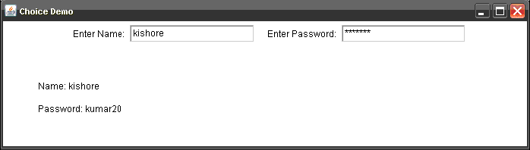
public void actionPerformed (ActionEvent ae)
{ repaint ();
}
public void paint (Graphics g)
{ g.drawString ("Name: "+ name.getText (), 50, 120);
g.drawString ("Password: "+pass.getText (), 50, 150);
}
public static void main (String args[])
{ MyText ob = new MyText ();
ob.setSize (500,200);
ob.setTitle ("Choice Demo");
ob.setVisible (true);
}
}

Slide 49
Scroll bars
Scrollbar class is useful to create scrollbars that can be attached to a frame or text area. Scrollbars can be arranged vertically or horizontally.
To create a scrollbar : Scrollbar sb = new Scrollbar (alignment, start, step, min, max);
alignment: Scrollbar.VERTICAL, Scrollbar.HORIZONTAL
start: starting value (e.g. 0)
step: step value (e.g. 30) // represents scrollbar length
min: minimum value (e.g. 0)
max: maximum value (e.g. 300)
To know the location of a scrollbar: int n = sb.getValue ();
To update scrollbar position to a new position: sb.setValue (int position);
To get the maximum value of the scrollbar: int x = sb.getMaximum ();
To get the minimum value of the scrollbar: int x = sb.getMinimum ();
To get the alignment of the scrollbar: int x = getOrientation ();
return 0 if the scrollbar is aligned HORIZONTAL, 1 if aligned VERTICAL.

Slide 50
Example – Scroll bars
Program 13: Program to create a vertical scrollbar
import java.awt.*;
import java.awt.event.*;
class MyScroll extends Frame implements AdjustmentListener
{ String msg = "";
Scrollbar sl;
MyScroll ()
{ setLayout (null);
sl = new Scrollbar (Scrollbar.VERTICAL, 0, 30, 0, 400);
sl.setBounds (250, 50, 30, 200);
add (sl);
sl.addAdjustmentListener (this);
addWindowListener (new WindowAdapter ()
{ public void windowClosing (WindowEvent we)
{ System.exit (0);
}
});
}
public void adjustmentValueChanged (AdjustmentEvent ae)
{ repaint ();
}

Slide 51
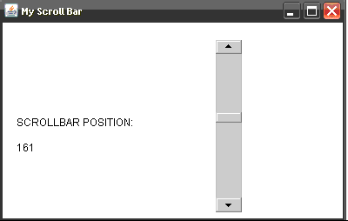
public void paint (Graphics g)
{ g.drawString ("SCROLLBAR POSITION: ", 20, 150);
msg += sl.getValue ();
g.drawString (msg, 20,180);
msg = "";
}
public static void main (String args[])
{ MyScroll ms = new MyScroll ();
ms.setTitle ("My Scroll Bar");
ms.setSize (400, 250);
ms.setVisible (true);
}
}
Output:

Slide 52
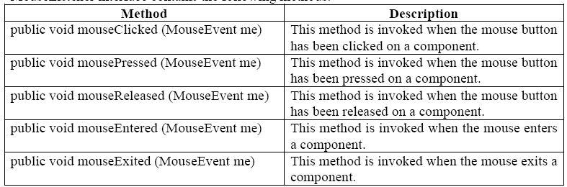
Handling Mouse Events
The user may click, release, drag or move a mouse while interacting with the application. If the programmer knows what the user has done, he can write the code according to the mouse event.
To trap the mouse events, MouseListener and MouseMotionListener interfaces of jav.awt.event package are used.
MouseListener interface contains the following methods:

Slide 53
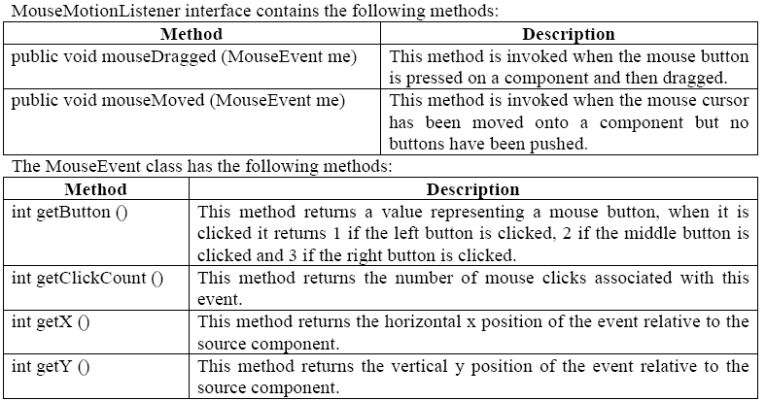

Slide 54
Example – Mouse Events
Program 14: Program to demonstrate the mouse events.
import java.awt.*;
import java.awt.event.*;
class MouseEvents extends Frame implements MouseListener, MouseMotionListener
{ int x,y;
MouseEvents ()
{ setLayout (new FlowLayout());
addMouseListener (this);
addMouseMotionListener (this);
addWindowListener (new WindowAdapter ()
{ public void windowClosing (WindowEvent we)
{ System.exit (0);
}
});
}
public void paint (Graphics g)
{ g.drawString (x +" , "+ y, x, y);
}
public void mouseClicked (MouseEvent me)
{ setBackground (Color.yellow);
}

Slide 55
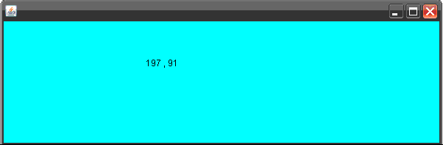
public void mousePressed(MouseEvent me)
{ setBackground (Color.red);
}
public void mouseReleased(MouseEvent me)
{ setBackground (Color.green);
}
public void mouseEntered (MouseEvent me)
{ setBackground (Color.blue);
}
public void mouseExited(MouseEvent me)
{ setBackground (Color.white);
}
public void mouseDragged(MouseEvent me)
{ setBackground (Color.black);
}
public void mouseMoved(MouseEvent me)
{ x = me.getX (); y = me.getY ();
setBackground (Color.cyan);
repaint ();
}
public static void main(String args[])
{ MouseEvents ob = new MouseEvents ();
ob.setSize(600,200);
ob.setVisible(true);
}}

Slide 56
Handling Keyboard Events
A user interacts with the application by pressing keys on the keyboard.
A programmer should know which key the user has pressed on the keyboard. These are also called ‘events’.
Knowing these events will enable the programmer to write his code according to the key pressed.
KeyListener interface of java.awt.event package helps to know which key is pressed or released by the user. It has 3 methods:

Slide 57
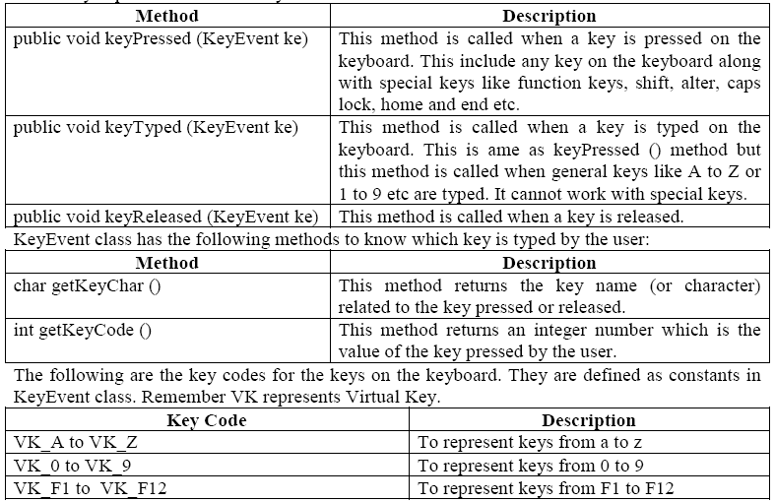
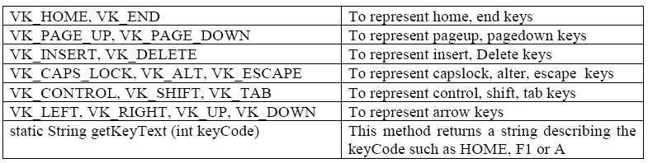

Slide 58
Program 15: Program to trap a key which is pressed on the keyboard.
import java.awt.*; import java.awt.event.*;
class KeyBoardEvents extends Frame implements KeyListener
{ String str =" ";
KeyBoardEvents ()
{ addKeyListener (this);
addWindowListener (new WindowAdapter ()
{ public void windowClosing (WindowEvent we)
{ System.exit (0);
}
});
}
public void paint (Graphics g)
{ g.drawString (str, 100, 100);
str = " ";
}
public void keyPressed (KeyEvent ke)
{ int keyCode = ke.getKeyCode();
if ( keyCode == KeyEvent.VK_F1)
str += "F1 key";
if ( keyCode == KeyEvent.VK_HOME)
str += "Home key";
repaint ();
}

Slide 59
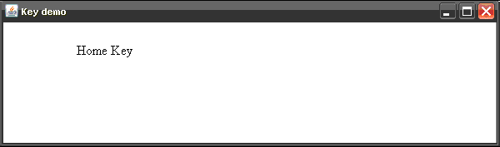
public void keyReleased (KeyEvent ke)
{
}
public void keyTyped (KeyEvent ke)
{
}
public static void main (String args[])
{ KeyBoardEvents ob = new KeyBoardEvents ();
ob.setTitle ("Key demo");
ob.setSize (600,450);
ob.setVisible (true);
}
}
Output:

Slide 60
Self -Review Questions
What is meant by AWT? What are the AWT classes contained in the java.awt package? Discuss each of them briefly.
What are Scroll bars? List out and explain various constructors and methods defined in it.
Write a sample Java program to demonstrate the usage of Scroll bars.
Write Java program for handling keyboard events.
Distinguish between TextField and TextArea classes.
What are the methods supported by KeyListener interface and MouseListener interface. Explain each of them with examples.

